Slide 1
BT201
Biochemical Process Calculations
Energy Balance
Terminologies and concept
19/10/2022

Slide 2
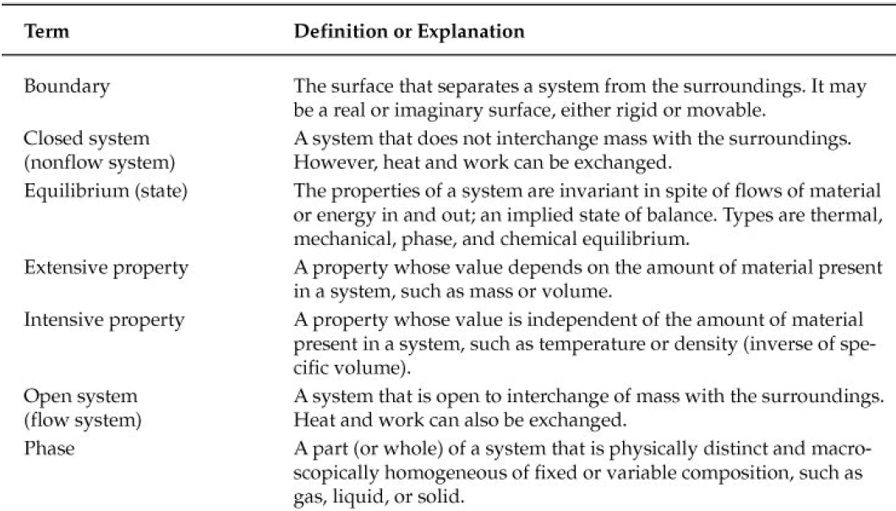
Terminologies: A review

Slide 3
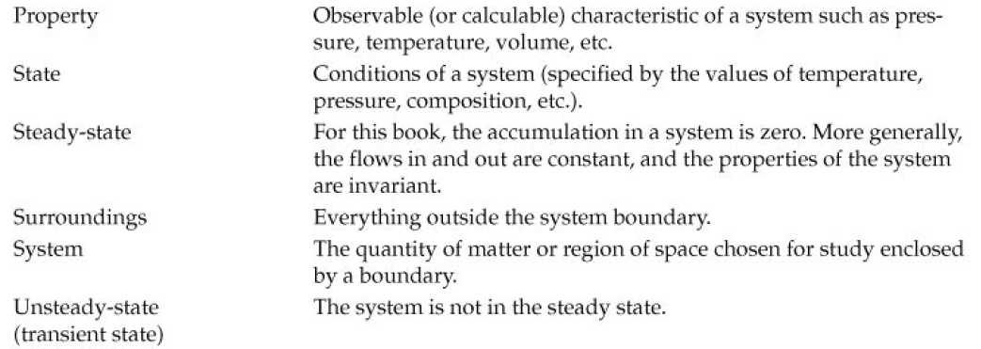
Cont..

Slide 4
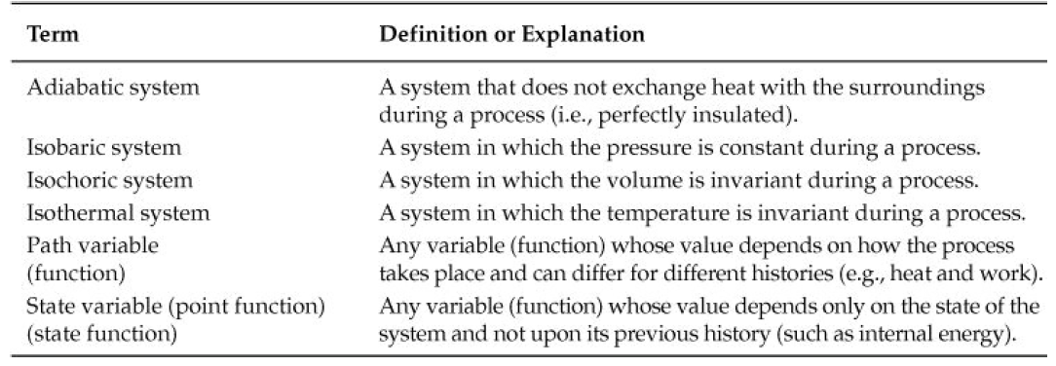
Additional terminologies

Slide 5
Forms of energy to be included in the energy balance
Suppose a process system is closed meaning that no mass is transferred across its boundaries while the process is taking place.
Energy may be transferred between such a system and its surroundings in two ways:
As heat, or energy that flows as a result of temperature difference between a system and its surroundings. The direction of flow is always from a higher temperature to a lower one.
As work or energy that flows in response to any driving force other than a temperature difference, such as a force, a torque, or a voltage.
For example, if a gas in a cylinder expands and moves a piston against a restraining force, the gas does work on the piston (energy is transferred as work from the gas to its surroundings, which include the piston. Here work is defined as positive when it is done by the system on the surroundings. This convention is arbitrary.

Slide 6


Slide 7


Slide 8

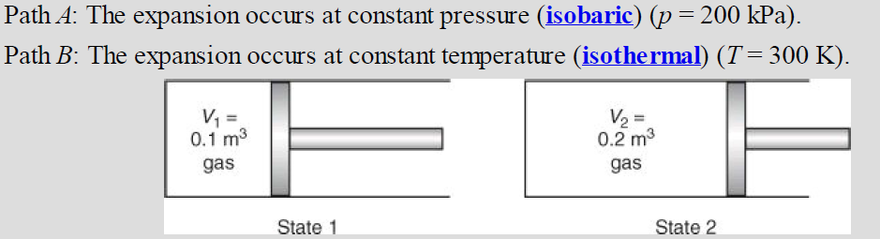
Calculation of mechanical work

Slide 9
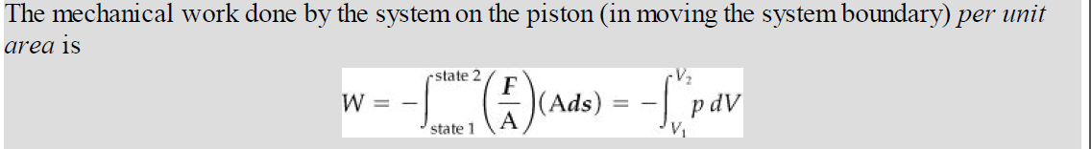
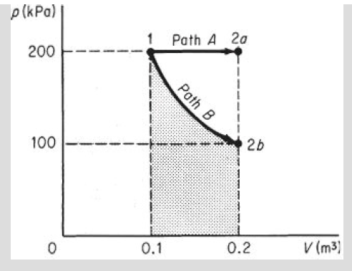
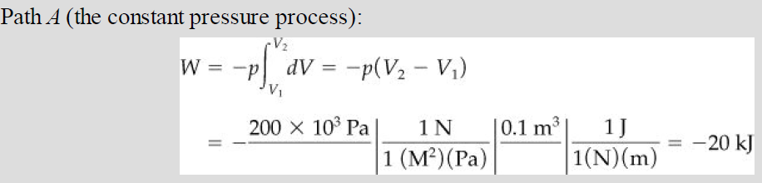

Slide 10

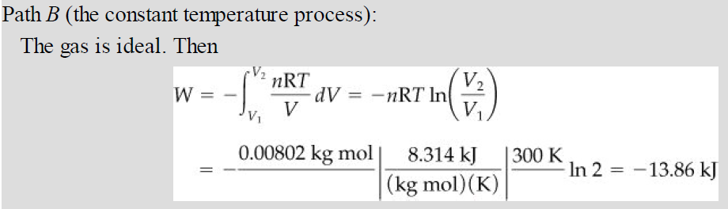

Slide 11
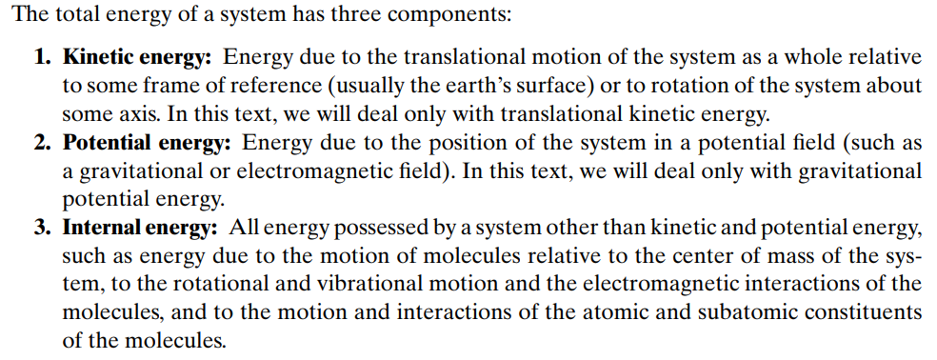

Total energy
PE=mgh

Slide 12
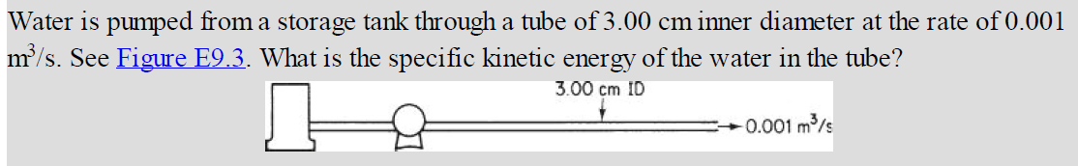
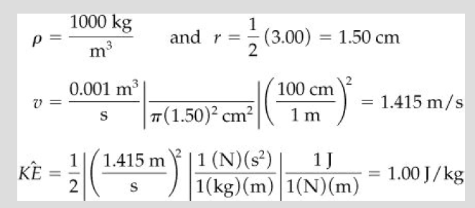

Slide 13
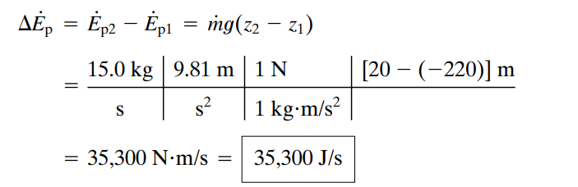
Crude oil is pumped at a rate of 15.0 kg/s from a point 220 meters below the earth’s surface to a point 20 meters above ground level. Calculate the attendant rate of increase of potential energy

Slide 14
Internal Energy (U)
Point or state variable
Macroscopic concept that accounts for all the molecular, atomic and subatomic energies
All forms follow microscopic laws of conservation for dynamic systems
Calculated based on, P ,T , V and composition of the system
Specific internal energy
Specific internal energy is a state variable and can be stored.
internal energy per unit mass (Û)
Because no instruments exist with which to measure internal energy directly on a macroscopic scale, internal energy must be calculated from certain other variables that can be measured macroscopically, such as pressure, volume, temperature, and composition.

Slide 15



Cont.
To calculate the internal energy per unit mass (Û) from variables that can be measured, use phase rule.
For a pure component in one phase, Û can be expressed in terms of just two intensive variables according to the phase rule: F = C-P+2 = 1-1+2 = 2
Typically use of temperature and specific volume as the two variables.
For a single phase and single component, we say that Û is a function of only T and V
Changes in the internal energy over a specified time interval can usually be computed as follows:
For an ideal gas Û is a function of temperature only. Always keep in mind that Equation alone is not valid if a phase change occurs during the interval.
Note that you can only calculate differences in internal energy, or calculate the internal energy relative to a reference state, but cannot calculate absolute values of internal energy.

Slide 16

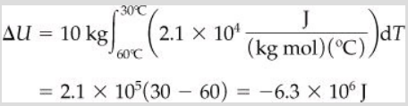
Multicomponent
The internal energy of a system containing more than one component is the sum of the internal energies of each component:
What is the change in internal energy when 10 kg mol of air are cooled from 60°C to 30°C in a constant volume process? Cν =2.1 × 10⁴ J/(kg mol)(°C)

Slide 17
What would be the value of ΔU for a constant volume system if 1 kg of water at 100 kPa was heated from 0°C to 100°C, and then cooled back to 0°C and 100 kPa? Would ΔÛ = 0?
Ans: Yes, because it is a state variable, and the integral in Equation would be zero because Û2 = Û1
For ideal gases, U is a function of temperature only

Slide 18

Enthalpy (H)
Measure of total energy of a thermodynamic system
It includes internal energy and energy required to make room for it by displacing its environment and establishing its volume and pressure
State function
Extensive quantity, can be converted to intensive property and get specific enthalpy (enthalpy per unit mass)
Alco called as thermodynamic potential
H=U+PV

Slide 19



Specific enthalpy for single phase and single component system
As internal energy, the state for the enthalpy for a single phase and single component can be completely specified by two intensive variables. We will express the enthalpy in terms of the temperature and pressure (the former a more convenient variable than the specific volume). If we let
By definition (∂Ĥ/∂T)_{p} is the heat capacity at constant pressure and is given the special symbol C_{p} .
For most practical purposes (∂Ĥ/∂p)_{T} is so small at modest pressures that the second term on the right-hand side of equation can be neglected. Changes in the specific enthalpy can then be calculated by integration of Equation as follows:

Slide 20
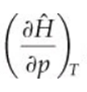
Terminologies: A review
Integral equation is not valid if there is phase change
One property of ideal gases, but not of real gases, to remember is that their enthalpies and internal energies are functions of temperature only and are not influenced by changes in pressure or specific volume.
At higher pressure is not negligible
Also, the relation between Cp and Cν for an ideal gas is Cν = Cp – R.
Only difference can be calculated, not absolute value.
Enthalpy relative to a reference point can be calculated
Total enthalpy of a system containing more than one component is sum of enthalpy of all components based on mass of each component

Slide 21
Example
Ex: The air that you breath is immediately warmed up from the ambient air temperature to 37 °C before entering your lungs. Calculate the specific enthalpy change when the temperature of air is raised from 20 ° C to 37 °C. assume the air is bone dry (0% humidity)
Cp of air= 28.94+0.4147 x 10⁻² T+0.3191 X 10⁻⁵ T² -1.965 X 10⁻⁹ T³ J/mol-°C
T₁=20
T₂=37
Specific enthalpy change =494 J/moles

